Slide 1

McFadden Project Presentation
By Luke,Madalina,Ciaran,Kris

Slide 2

McFadden
The McFaddan Online Music Store will serve as a digital platform that functions as a virtual display for an electronic music shop. This platform will provide consumers with convenient access through a login/register method, allowing them to browse and view all available products categorised accordingly. Additionally, customers will have the ability to add or remove items from their virtual shopping cart and proceed with purchasing their desired products

Slide 3
Deliverable
A fully functional and responsive e-commerce website
A customer registration and login system
A shopping cart feature
Inventory management (Add/Update/Delete)

Slide 4
Technologies
In the task to create our McFadden website, we'll employ a combination of essential technologies to ensure a robust and dynamic platform. For the front-end structure and styling, we'll utilize HTML for the webpage structure and CSS/Bootstrap to craft a distinctive and visually appealing appearance. Moving on to the back-end development, we'll implement the server-side logic using PHP in conjunction with the CodeIgniter framework for a structured and efficient development process.
Notepad++ will be our text editor of choice for coding, providing a lightweight and feature-rich environment for web development.
For the database management aspect, we'll integrate PhpMyAdmin with CodeIgniter to establish a secure and organized database structure. This involves connecting the PhpMyAdmin database to our CodeIgniter project, facilitating seamless data population and retrieval.

Slide 5
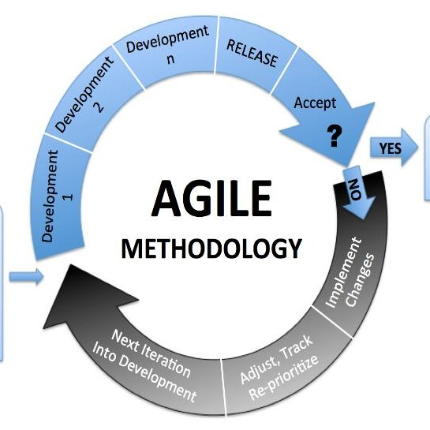
Agile Methodology
Consist in weekly meetings
Choose use cases and complete them
Implementing the feedbacks
Prevent waste of time for both developers and customers.

Slide 6
Process Overview
Weekly meetings
We scheduled weekly meetings to open/ build the communication between the team members.
We ensured all the members are present to share the progress updates , challenges and upcoming goals for the project.
This helped us on creating a collaborative environment for effective information exchange.

Slide 7
Use cases selection
We prioritised use cases based on strategic goals and customer priorities.
We made sure each member choose a manageable number of use cases that they will implement in the project aligning with the customer needs and that it meets the project objectives.
This process allowed us to break things down and use what we have wisely and work in a way that helps us get better fast.

Slide 8
Feedback Integration
We collected feedbacks from both group members and customer at the weekly meetings allowing us to improve the project quickly using helpful suggestions. This resulting an adaptive mindset for continuous improvement.
This proactive identification and resolution of issues prevented us from unnecessary time wastage

Slide 9
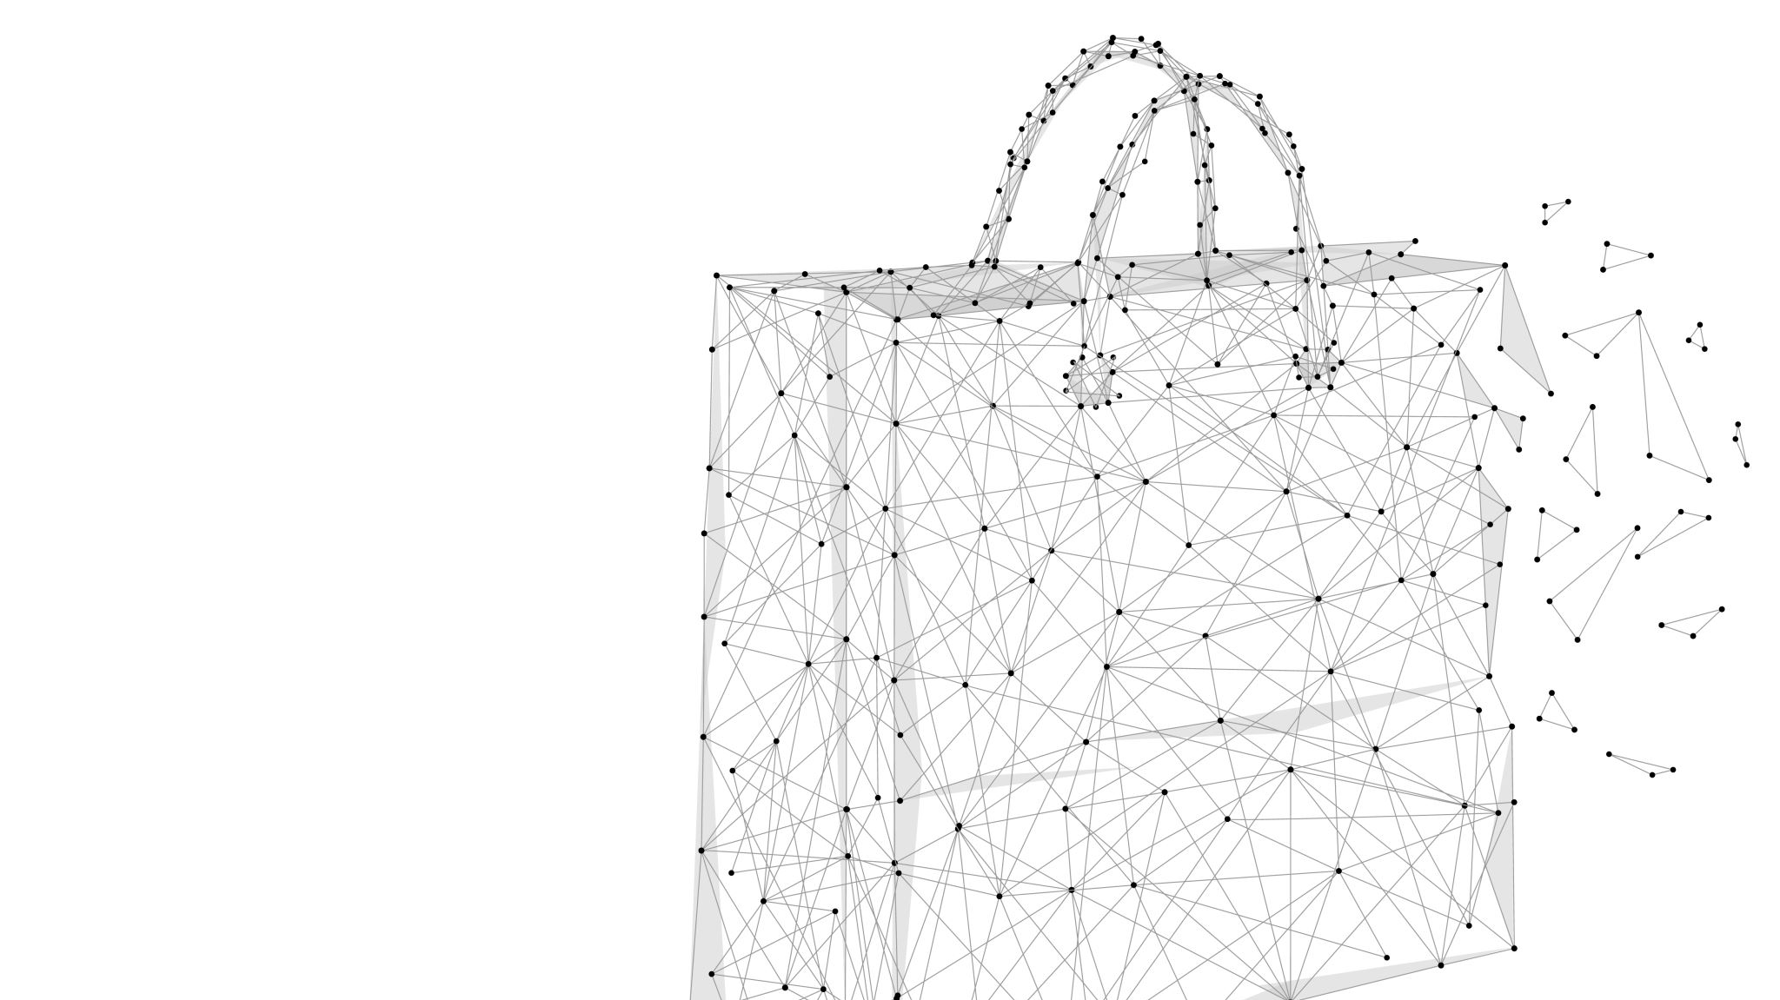
Product Backlog

Slide 10
We made plans for the project, listing different things it can do. We picked the most important ones and plan to make them happen in the next three months. We put them in order to make sure we focus on the most crucial parts first.

Slide 11
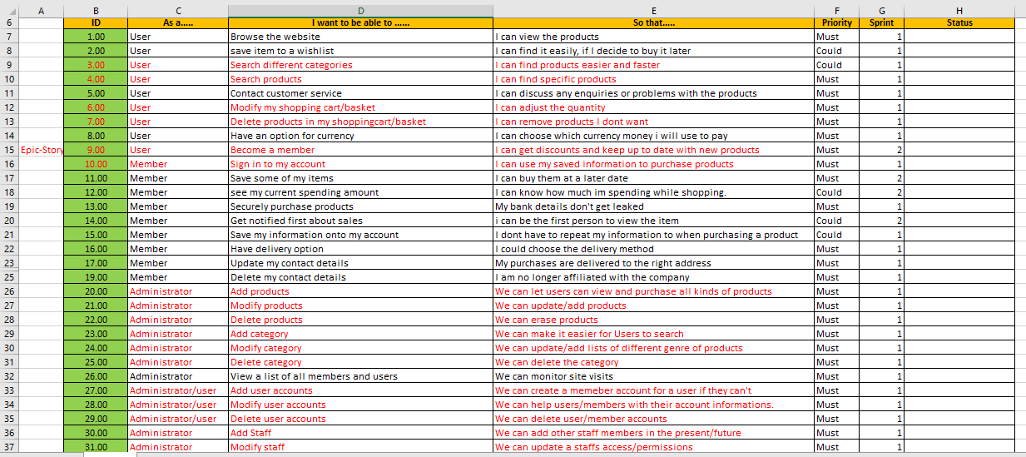

Slide 12
Use CASES
Use cases are vital in project development, offering a practical roadmap for real-world scenarios.
Provide a clear picture of how our project will be utilized, ensuring a shared understanding among all stakeholders.
By defining use cases, we identified and analyzed project requirements, ensuring alignment with user needs and expectations.
Guide the creation of test scenarios, validating that the project behaves as expected in diverse real-world situations.

Slide 13
Use Cases Example
Use Case Name: Add New Product
Use Case Description: This use case allows the admin to add a new product to the online store.
Participating Actor(s): On-line Admin
Entry Conditions: The admin must be logged into their account and have access to the product management feature.
Flow of Events:
1. The admin selects the "Add New Product" option from the product management menu.
2. The system responds by displaying a form for the admin to enter the product details.
3. The admin fills out the product details and selects the "Add Product" button.
4. The system responds by generating a unique product ID, adding the product to the database, and displaying a message to the admin indicating that the product has been added successfully.
Exit Condition(s): A new product has been created and added to the online store.

Slide 14
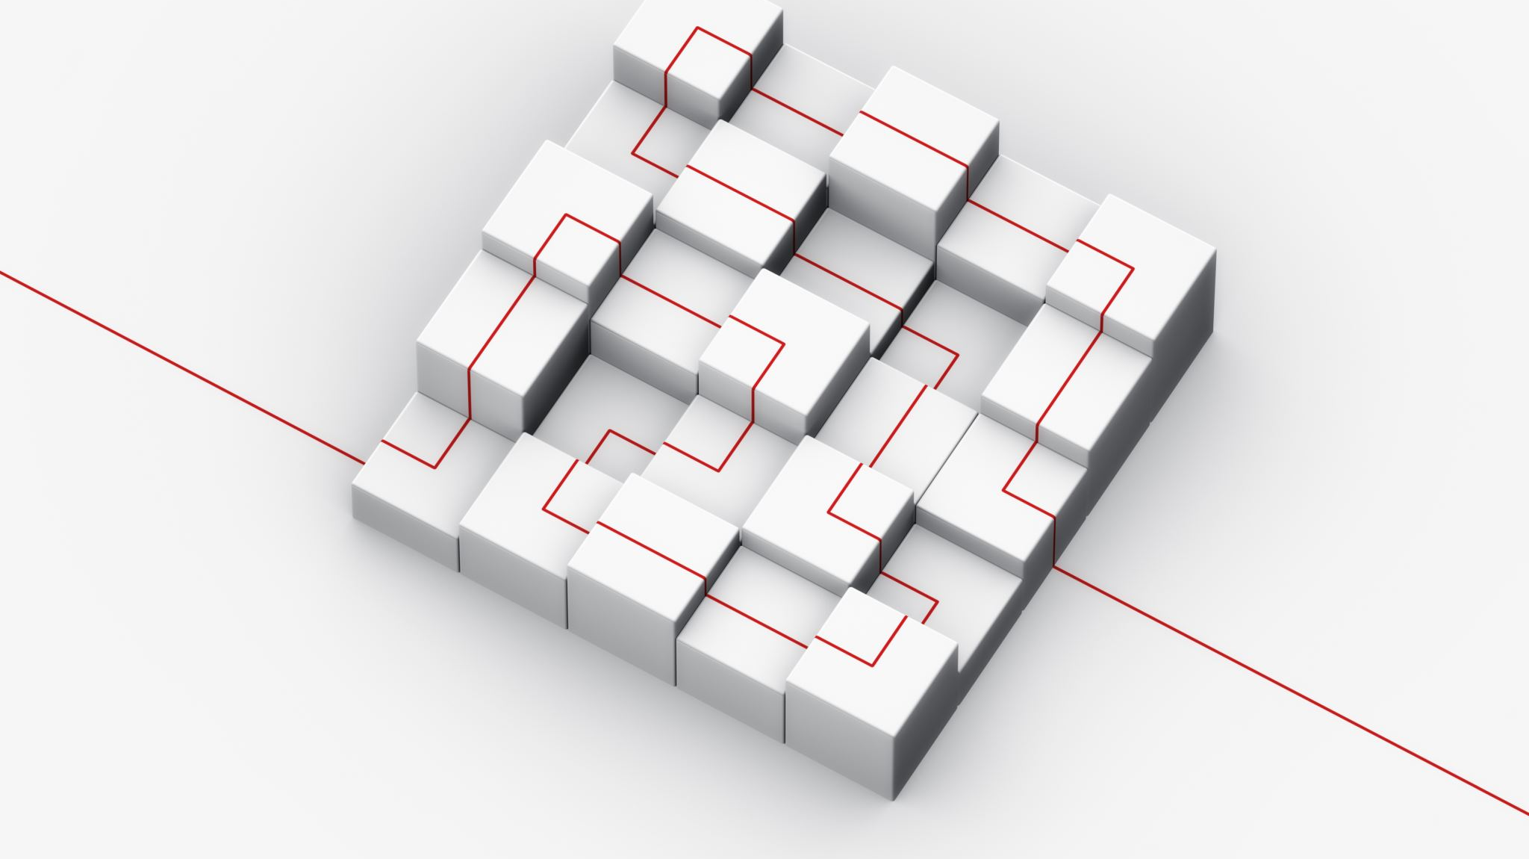
DataBase ERD diagram

Slide 15
Why ERD?
Creating a successful website involves careful planning, and a key part of this is designing a good database.
ERD provides a clear visual representation of how data is organized in the database, aiding in structural clarity.
It helps map out relationships between entities, such as users, products, and orders, reflecting real-world interactions within the website.
ERDs serve as a powerful communication tool among developers, designers, and stakeholders. It establishes a common visual language for discussing and understanding the database structure

Slide 16
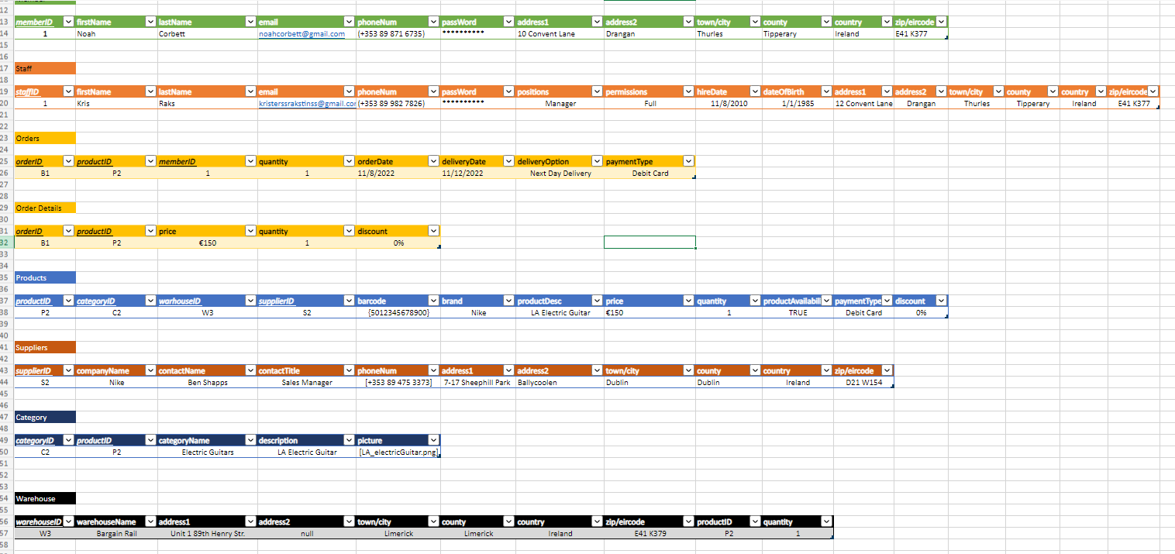

Slide 17
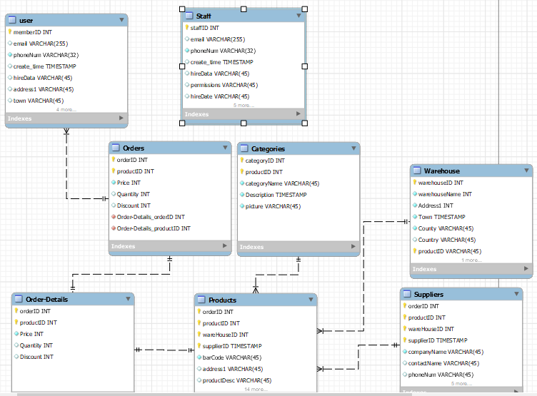

Slide 18
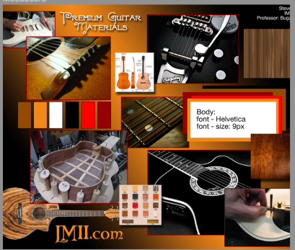
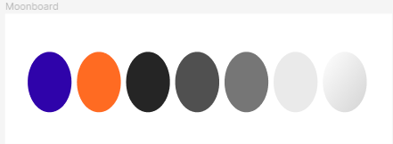
MoodBoard
Our group collectively decided on two themes: modern and vintage. In response to this, we decided to explore both modern and vintage themes, presenting a diverse range of options. By doing so, we aim to offer the product owner the opportunity to choose the theme that best resonates with the desired image and professionalism for the musical instruments website.
Vintage colors often evoke a sense of nostalgia and retro charm. This can create a warm and familiar feeling, resonating with users who appreciate a throwback to a particular era
Modern colors are often associated with contemporary design trends, providing a fresh and current look to your website.

Slide 19
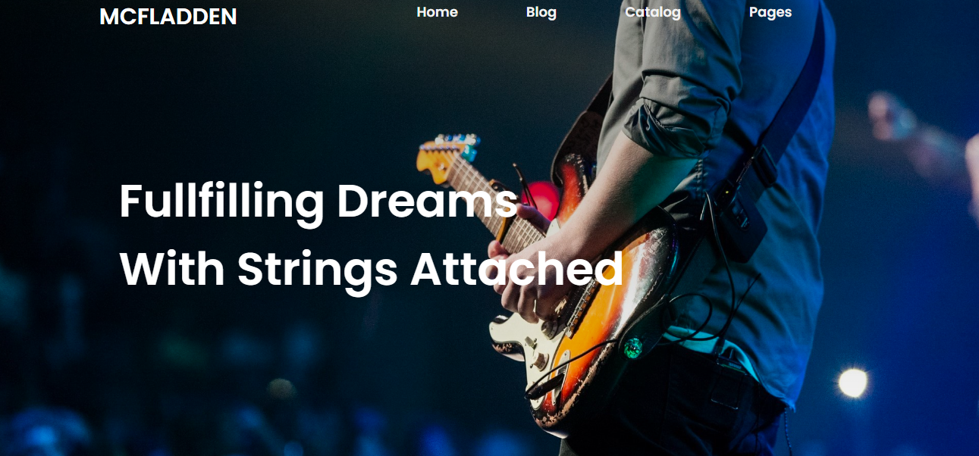
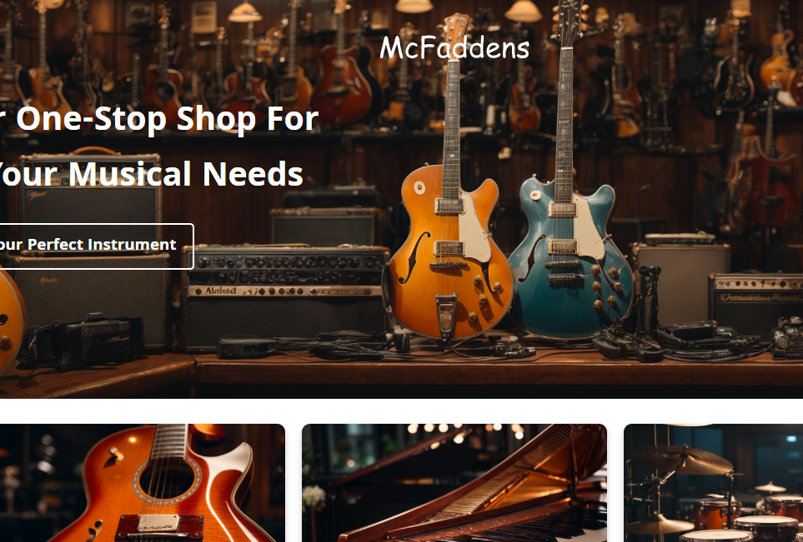
Landing page prototype

Slide 20
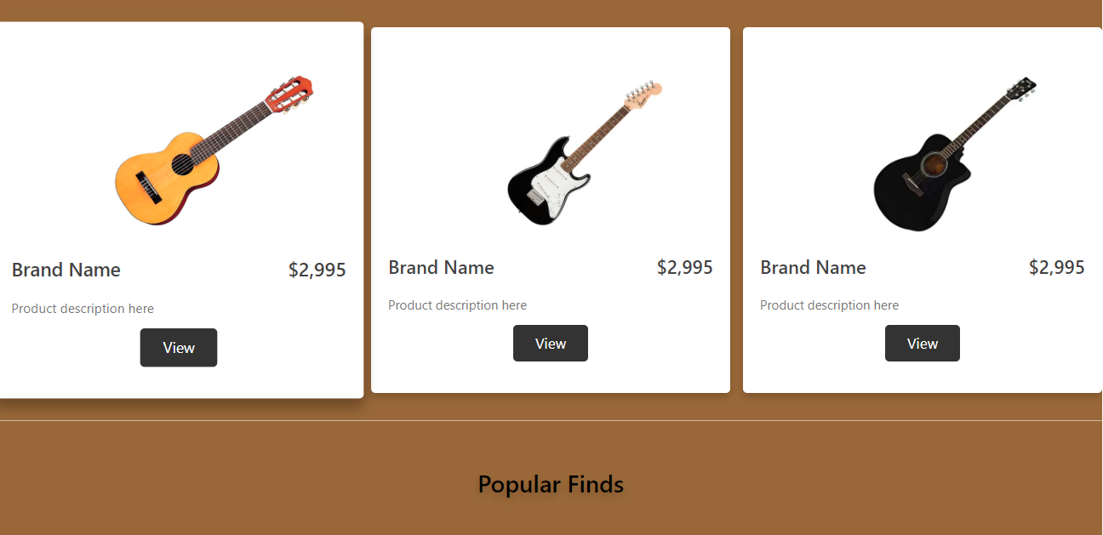
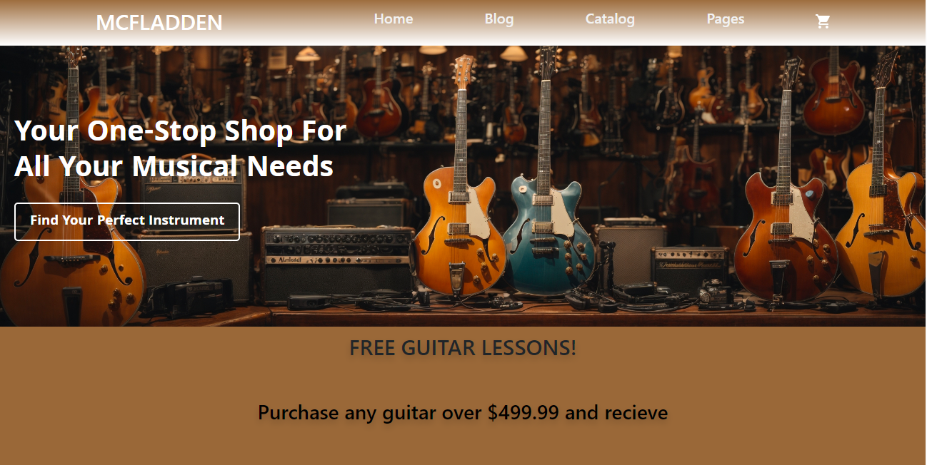
Final Landing page

